Slide 1
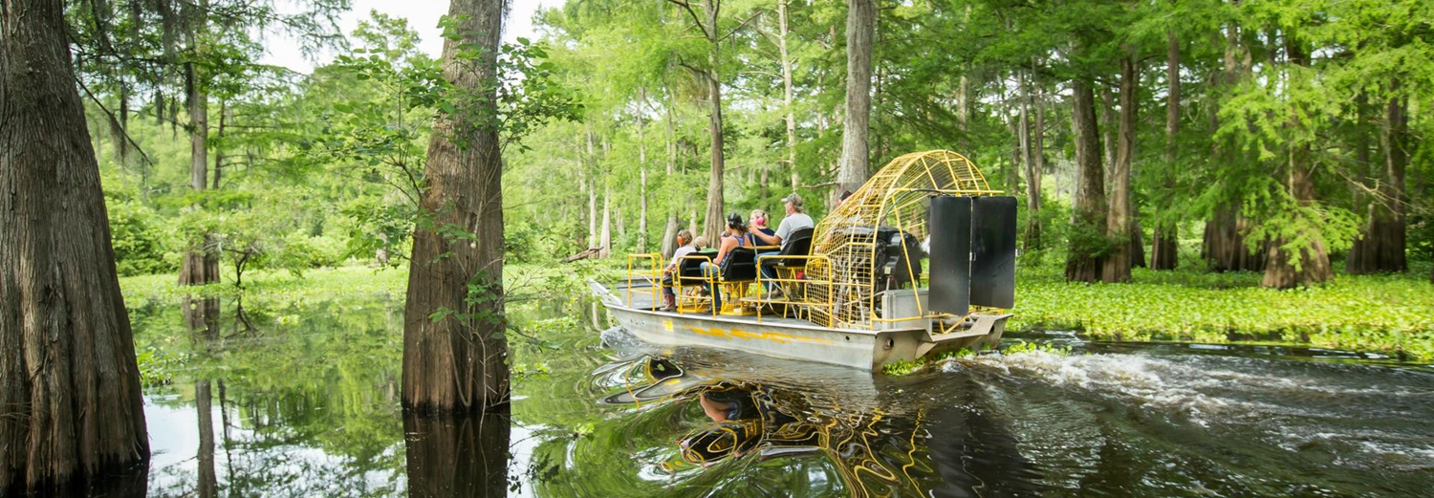
SWAMP AI in LA
The Structured Workforce and Multi-Institutional Partnerships for AI in LA proposal was submitted in response to the FIPSE USDOE opportunity under Absolute Priority 1: Advancing Artificial Intelligence to Improve Educational Outcomes of Postsecondary Students.
The proposed project also addresses absolute priorities 2,6, and 7 through supporting pre- and in-service educators integrating AI into learning from prek to professional levels and includes the designing and dissemination of short-term workforce upskilling and reskilling programs in a variety of sectors.

Slide 2
Concept to Collaboration
USDOE Released Opportunity -November 12
Team Members/ AI Experts Identified - November 14
Review of Other State Designs(Utah, Texas) and Concept Meeting(s) with AI Workgroup Members- November 17
First Full Higher Ed Team Meeting and Concept Review via zoom- November 19
First Proposal Draft Shared with the Team-November 20
Supporting Document Collection, Draft Budget, and Narrative Edits -Thanksgiving Break
Meeting with Prompt Engineering Expert and AI Workgroup Member - December 1
Final Draft Completed and Final Support Letters Received- December 3 by 4:40 pm
Proposal Submitted - December 3 at approximately 4:56pm

Slide 3
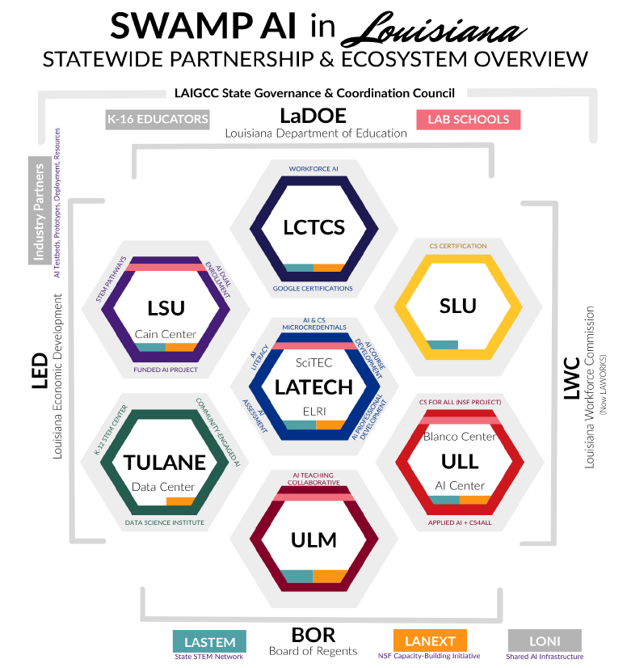
BESE
Notes:
Statewide Higher Education Consortium: Louisiana Tech (lead), LSU, Tulane, ULL, ULM, SLU, and the Louisiana Community & Technical College System—covering research universities, regional universities, and community colleges.
PK–12 and Education Agencies: Louisiana Department of Education (LDOE), BESE, university lab schools, and district partners enable direct classroom deployment and educator training statewide.
Workforce & Economic Development Partners: Louisiana Workforce Commission (LWC) and Louisiana Economic Development (LED) ensure alignment with job demand, credentials, and industry attraction.
Industry & Nonprofit Partners: Cyber.org, T-Mobile, and sector partners in energy, healthcare, manufacturing, agriculture, and ports support real-world use cases, connectivity, and scale.
Advanced Infrastructure Assets: LONI statewide fiber network and high-performance computing (QB3 & QB4 GPU clusters) provide immediate AI compute capacity for education and research.
Proven Program Platforms: Coursera enterprise access, Google AI microcredentials, LASTEM STEM network, LANEXT NSF research network, and FUEL industry–academic model reduce startup risk.
Demonstrated Execution Capacity: Partners have successfully scaled statewide initiatives (e.g., Science of Reading, CS standards, AI microcredentials), proving Louisiana can move from pilots to statewide impact.
SWAMP AI in LA will function as Louisiana’s statewide hub for AI-enabled teaching, learning, and student support by coordinating institutional, state, and employer partners to achieve these outcomes.
These partnerships ensure alignment that includes sharing of data and partnerships for workforce outcomes to ensure that AI-enabled instruction translates into improved educational and labor-market outcomes.

Slide 4
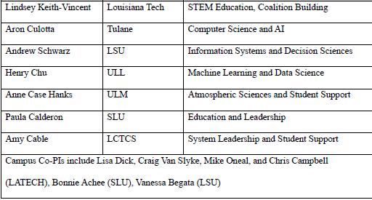
SWAMP AI in LA Higher Education Leaders

Slide 5
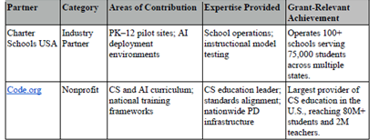
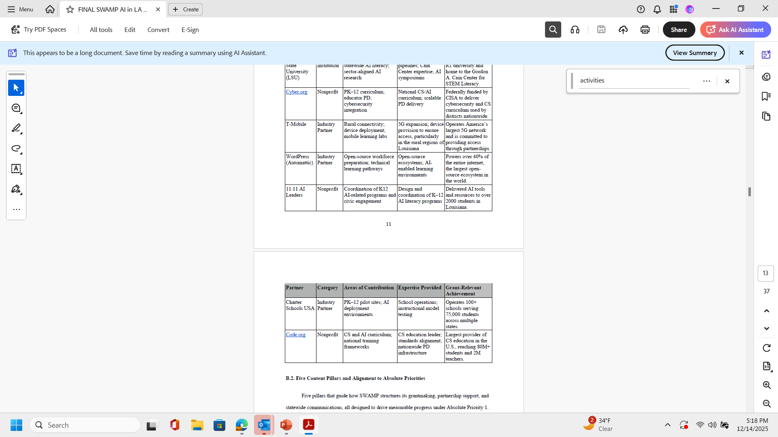
Notes:
Statewide Higher Education Consortium: Louisiana Tech (lead), LSU, Tulane, ULL, ULM, SLU, and the Louisiana Community & Technical College System—covering research universities, regional universities, and community colleges.
PK–12 and Education Agencies: Louisiana Department of Education (LDOE), BESE, university lab schools, and district partners enable direct classroom deployment and educator training statewide.
Workforce & Economic Development Partners: Louisiana Workforce Commission (LWC) and Louisiana Economic Development (LED) ensure alignment with job demand, credentials, and industry attraction.
Industry & Nonprofit Partners: Cyber.org, T-Mobile, and sector partners in energy, healthcare, manufacturing, agriculture, and ports support real-world use cases, connectivity, and scale.
Advanced Infrastructure Assets: LONI statewide fiber network and high-performance computing (QB3 & QB4 GPU clusters) provide immediate AI compute capacity for education and research.
Proven Program Platforms: Coursera enterprise access, Google AI microcredentials, LASTEM STEM network, LANEXT NSF research network, and FUEL industry–academic model reduce startup risk.
Demonstrated Execution Capacity: Partners have successfully scaled statewide initiatives (e.g., Science of Reading, CS standards, AI microcredentials), proving Louisiana can move from pilots to statewide impact.
SWAMP AI in LA will function as Louisiana’s statewide hub for AI-enabled teaching, learning, and student support by coordinating institutional, state, and employer partners to achieve these outcomes.
These partnerships ensure alignment that includes sharing of data and partnerships for workforce outcomes to ensure that AI-enabled instruction translates into improved educational and labor-market outcomes.

Slide 6

Solving Problems: Louisiana Starts from a Weak Educational Baseline
Louisiana ranks near the bottom nationally in higher education attainment and workforce participation.
These gaps already limit economic mobility—AI will magnify them if access to AI education is uneven.
Without intervention, AI becomes an accelerant of inequality rather than a tool for opportunity.

Slide 7
Solving Problems: Employers Expect AI Skills, Education Does Not Yet Deliver
Louisiana currently has more than 114,000 open jobs and only 58% workforce participation.
National surveys show employers now prefer candidates with AI skills—even over more experienced workers without them; and AI literacy is becoming a baseline employability requirement, not a specialized skill.
Education and training pathways are not yet aligned to this reality at scale.

Slide 8
Solving Problems: AI Education Exists—but Only for a Few
Louisiana has strong AI assets: universities, HPC infrastructure, industry investment, and early pilots.
However, access depends on geography, institution, and individual initiative;
Rural districts, community colleges, and under-resourced schools are least likely to benefit.
There is no statewide mechanism to coordinate, scale, or sustain AI education efforts.

Slide 9
Solving Problems: The Cost of Doing Nothing Is High
Students graduate unprepared for AI-enabled careers and decision-making.
Educators lack guidance and training, leading to fear-based restrictions rather than innovation.
Industry investment risks outpacing local talent availability.
Louisiana misses a narrow window to lead rather than follow in AI-enabled education.

Slide 10

Overarching Goals of SWAMP AI in LA
● Improve postsecondary student learning, course completion, and credit accumulation through AI-integrated instruction, high-impact tutoring, and adaptive learning tools in high-enrollment and gateway courses.
● Increase student use of AI-enabled advising and college/career navigation tools that support persistence, on-time progression, and transition into high-demand AI-linked pathways.
● Expand the number of faculty and programs that embed AI literacy skills and concepts into teaching and assessment, including responsible AI use and detection of AI-generated misinformation and disinformation.
● Grow participation in AI-aligned dual-enrollment, bridge, and microcredential offerings that improve persistence, transfer, and credential completion for Louisiana students.
● Create and scale short-term, AI-aligned postsecondary programs to improve job placement, retention, and earnings in high-demand sectors aligned with Louisiana workforce priorities.

Slide 11
SWAMP AI Five-Pillar Framework
1. Statewide AI Infrastructure & Capacity
2. AI Workforce Development & Talent Pipelines
3. Real-World Deployment & Industry Impact
4. Community Engagement & Public Trust
5. Responsible AI Research & Governance

Slide 12
SWAMP AI’s Statewide Impact
Pillar | Goals | Measurable Impacts
Pillar 1: Statewide AI Infrastructure & Capacity | 1. Establish shared AI computing, data, and cloud infrastructure. 2. Develop a statewide framework for responsible AI governance. 3. Create interoperable AI toolkits and datasets for priority sectors. | • 100% of students and faculty have access to shared AI tools by Year 2. • Responsible AI governance framework adopted by all universities within 18 months. • 15 multi-institutional AI research collaborations and 10 shared datasets by Year 3.
Pillar 2: AI Workforce Development & Talent Pipelines | 1. Create stackable micro credentials and certificates. 2. Deliver experiential, project-based AI learning. 3. Train educators to integrate AI into teaching. | • 10+ microcredentials; 2,500 students enrolled in AI programs. • 1,200 students engaged in experiential AI projects. • 500 educators certified in AI pedagogy.
Pillar 3: Real-World Deployment & Industry Partnerships | 1. Develop applied AI solutions for Louisiana industries. 2. Build community and industry AI testbeds. 3. Support commercialization and tech transfer. | • AI solutions deployed with at least 15 partners. • 3 AI testbeds; 20 student–industry projects. • 8 prototypes, 5 patent disclosures, 3 startup projects.
Pillar 4: Community Engagement, Equity, & Public Trust in AI | 1. Expand AI literacy statewide. 2. Increase access for underserved and rural communities. 3. Co-design AI tools with local stakeholders. | • 60+ workshops; 4,000 residents served. • 40% participation from underserved regions. • Partnerships with 15 community organizations.
Pillar 5: Research, Ethics, & Responsible AI Governance | 1. Conduct interdisciplinary responsible AI research. 2. Establish statewide ethical AI standards and training. 3. Integrate responsible AI into curriculum. | • 25 publications, 10 white papers, 5 research grants. • 3,000 students and 500 faculty trained. • Ethical AI modules in 40+ courses.

Slide 13
SWAMP AI Annual Activities
Establish Central Communication & Coordination Hub
Design Funding Opportunities and Oversee Management of Grant, Awards, and Subcontracts
Host an Annual Statewide Convening
Host Regional Convenings
Host an Annual Statewide Summit

Slide 14
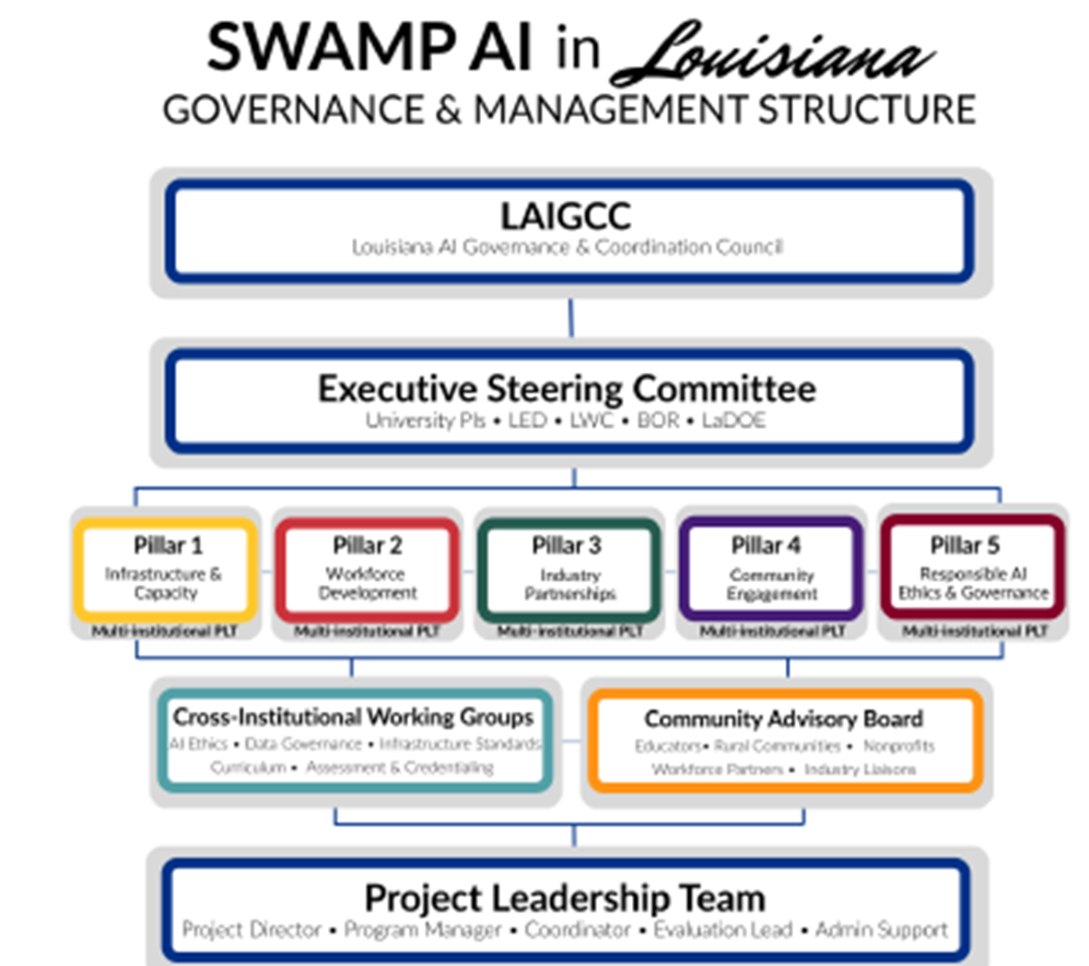
Notes:
Establish Central Communication & Coordination Hub. This will include establishing a statewide online portal and email system that aggregates and distributes AI-enabled instructional resources, high-impact tutoring tools, AI literacy modules, advising and degree-planning models, and data dashboards to faculty, student-success staff, and students. The hub will also support SEA/LEA partnerships where AI tools used in dual-enrollment and bridge courses directly improve postsecondary readiness and success.
Management of Grant, Awards, and Subcontracts. SWAMP will lead a competitive subaward program funding institutional projects that redesign gateway and high-enrollment courses using AI-driven personalization, virtual teaching assistants, and adaptive assessments; integrate AI literacy and responsible AI use into general education and program curricula; and deploy AI-enhanced advising, early-alert, and degree-navigation systems.
SWAMP leadership will host an Annual Statewide Convening. This annual event will be focused on postsecondary teaching and learning, where faculty, student-success leaders, CIOs, institutional researchers, and state partners. They will review outcome and implementation data from SWAMP-funded pilots; compare models of AI-enabled instruction, tutoring, and advising; and set future funding priorities based on demonstrated impact on postsecondary student outcomes.
In addition, SWAMP will host Regional Convening. These in-person convenings bring together campus teams, regional employers, and K–12 partners to ensure that SWAMP can extend AI-enabled instructional supports and tutoring models to LA campuses; align course redesign and advising strategies with regional workforce pathways; and share practical implementation lessons that raise student success
Host an Annual Statewide Summit designed to showcase postsecondary AI teaching, tutoring, and advising projects and their outcome data; disseminates open-licensed curricula, tools, implementation guides, and data dashboards; and allows the team to collect structured feedback from students, faculty, advisors, and institutional leaders to drive continuous improvement and replication.

Slide 15
Alignment with BESE AI Strategic Goals
BESE Strategic Goal | How the SWAMP AI in LA Proposal Aligns
1. Establish a Statewide Vision and Policy Framework for AI in Education | SWAMP AI in LA creates a coordinated, statewide AI education ecosystem that aligns PK–12, postsecondary, workforce, and state agencies around a shared vision of AI as educational infrastructure rather than isolated pilots.
2. Define a Statewide AI Literacy and Competency Framework | The proposal embeds AI literacy and applied competencies across PK–12, higher education, and workforce pathways through microcredentials, curriculum integration, and educator training, creating consistent expectations for AI proficiency statewide.
3. Set Standards and Criteria for Approved AI Tools and Platforms | Through shared governance structures and cross-institutional collaboration, the consortium supports the development of common evaluation criteria, vetted tools, and reusable AI resources, reducing risk and duplication for schools and districts.
4. Promote Responsible, Ethical, and Secure Use of AI | Responsible AI is a dedicated pillar of the proposal, including a statewide Responsible AI Framework, ethics training for educators and students, and a cross-university AI review process aligned with fairness, transparency, privacy, and security principles.
5. Align AI Integration with Workforce and Economic Development Needs | SWAMP AI in LA directly connects AI education to Louisiana’s workforce priorities, engaging industry partners, workforce agencies, and economic development organizations to ensure students graduate with AI skills aligned to real job demand.
6. Identify and Position Louisiana for Federal and Private Funding Opportunities | The consortium structure positions Louisiana as a competitive, fundable entity, enabling BESE, higher education, and state agencies to jointly pursue federal grants, philanthropic investments, and private partnerships that scale AI education statewide.

Slide 16
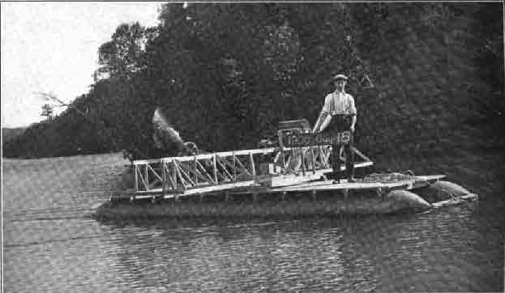
Brief Swamp Boat History
Alexander Graham Bell designed the first airboat prototype in 1905
Used for aviation experiments and testing different engines and propeller configurations
Utilized in 1915 by British troops during World War I
Adopted widely about 1930, popular among civilians, in the South
Without special adaptations, airboats cannot go in reverse
Slowing and stopping an airboat is more difficult than a normal watercraft because it rides on top of rather than in the water
Designed to be safe, move nimbly, and to access spaces that are typically hard to reach
Used today to take people into hard-to-reach spaces, to enjoy hobbies such as fishing and hunting support livelihood and employment, and for transportation in rural regions
Notes:
expand AI literacy, educator capacity, and workforce preparation; Louisiana will be able to take advantage of this once-in-a-generation opportunity to reposition its economy for the future. This proposal is designed in response to the national need to advance the understanding and use of AI in post-secondary education This solution is aligned with the Trump administration’s framework for artificial intelligence policy that reflects a heavy interest in boosting U.S. innovation.

Slide 17
“Artificial intelligence has the potential to revolutionize education and support improved outcomes for learners. It drives personalized learning, sharpens critical thinking, and prepares students with problem-solving skills that are vital for tomorrow’s challenges.”
-US Secretary of Education, Linda McMahon
Our SWAMP team invites you to get on the boat with us!
Notes:
expand AI literacy, educator capacity, and workforce preparation; Louisiana will be able to take advantage of this once-in-a-generation opportunity to reposition its economy for the future. This proposal is designed in response to the national need to advance the understanding and use of AI in post-secondary education This solution is aligned with the Trump administration’s framework for artificial intelligence policy that reflects a heavy interest in boosting U.S. innovation.

Slide 18
Swamp images retrieved from www.explorelouisiana.com.
History of Airboat information Airboat - Wikipedia
Referenced funding solicitation can be found at Federal Register :: Applications for New Awards; Fund for the Improvement of Postsecondary Education-Special Projects (FIPSE-SP)
Notes:
expand AI literacy, educator capacity, and workforce preparation; Louisiana will be able to take advantage of this once-in-a-generation opportunity to reposition its economy for the future. This proposal is designed in response to the national need to advance the understanding and use of AI in post-secondary education This solution is aligned with the Trump administration’s framework for artificial intelligence policy that reflects a heavy interest in boosting U.S. innovation.

